Slide 1
CASH FLOW STATEMENT

Slide 2
CASH FLOW STATEMENT
Cash flow statement is a statement that shows the flow of cash and cash equivalents during the period under report.
The following terms are used in this statement with the meanings specified:
CASH comprises cash on hand and demand deposits with banks.
Cash Equivalents are short term, highly liquid investments that are readily convertible into known amounts of cash and which are subject to an insignificant risk of changes in value.
Cash flows are inflows and outflows of cash and cash equivalents
Cash Flows
Inflows
Transactions that increase cash and cash equivalents
Outflows
Transactions that decrease cash and cash equivalents

Slide 3
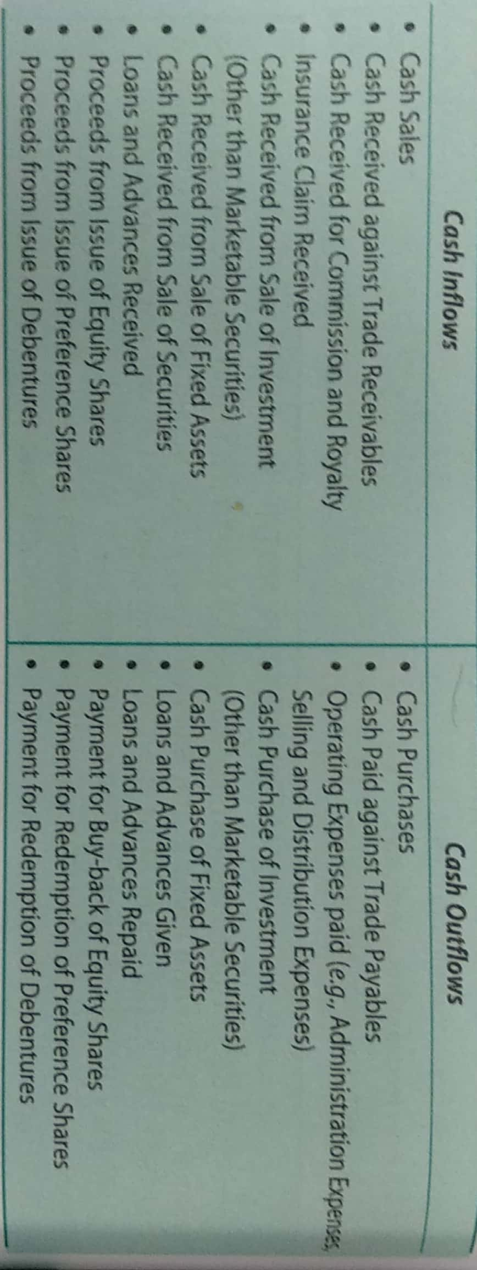

Slide 4
OBJECTIVES OF CASH FLOW STATEMENT
As per AS-3 (revised) the objective of CFS is to provide information about cash flows of an enterprise which is useful in providing the users of financial statement a basis to assess the ability of an enterprise to generate cash and cash equivalents to utilize those cash flows .
The revised AS-3 has made it mandatory for all listed companies to prepare and present a cash flow statement along with other financial statements on annual basis.

Slide 5
Need of Preparing Cash Flow Statement
i) Cash Flow Statement reveals the causes of changes in cash balances between two Balance Sheet dates.
(ii) This statement helps the management to evaluate its ability to meet its obligations i.e., payment to creditors, the payment of bank loan, payment of interest, taxes, dividend etc.
(iii) It throws light on causes for poor liquidity in spite of good profits and excessive liquidity in spite of heavy losses.
(iv) It helps the management in understanding the past behavior of cash cycle and in controlling the use of cash in future.
(v) Cash Flow Statements helps the management in planning repayment of loans, replacement of assets etc.
(vi) This statement is helpful in short-term financial decisions relating to liquidity.
vii) This statement helps the management in preparing the cash budgets properly.

Slide 6
Need of Preparing Cash Flow Statement
(viii) This statement helps the financial institution who lends advances to business concerns in estimating their repaying capacities.
(ix) Since a Cash Flow Statement is based on the cash basis of accounting it is very useful in evaluation of cash position of a firm.
(x) Cash Flow Statement discloses the complete story of cash movement. The increase in, or decrease of cash and the reason therefore can be known.
(xi) Cash Flow Statement provides information of all activities such as operating, investing, and financing activities separately.
(xii) Since Cash Flow Statement provides information regarding the sources and utilization of cash during a particular period, it is easy for the management to plan carefully for the cash requirements in the future, for the purpose of redeeming long-term liabilities or and replacing some fixed assets.
(xiii) A projected Cash Flow Statement reveals the future cash position of a concern. Through this Cash Flow Statement the firm can know how much cash it can generate and how much cash will be needed to make various payments.

Slide 7
IMPORTANCE OR USES OF CASH FLOW STATEMENT
Short term planning
Cash flow helps in assessing the liquidity and solvency
Efficient Cash Management
Comparative study
Reasons for cash positions
Evaluate Management Decisions
Dividend Decision

Slide 8
Limitations of Cash Flow Statement
(i) Cash Flow Statement is not suitable for judging the profitability of a firm as non-cash changes are ignored while calculating cash flows from operating activities.
(ii) Cash Flow Statement is not a substitute for Income Statement or Funds Flow Statement. Each of them has a separate function to perform. Net Cash Flow disclosed by Cash Flow Statement does not necessarily be the net income of the business, because net income is determined by taking into account both cash and non-cash items.
(iii) Cash Flow Statement is based on cash accounting. It ignores the basic accounting concept of a accrual basis.
(iv) Cash Flow Statement reveals the movement of cash only. In preparation it ignores most liquid current assets (ex: Sundry debtors, Bills Receivable etc.)
(v) It is difficult to precisely define the term cash. There are controversies among accountants over a number of near cash items like cheques, stamps, postal orders etc., to be included in cash.
(vi) Cash Flow Statement does not give a complete picture of financial position of the concern.
(vii) A Cash Flow Statement only reveals the inflow and outflow of cash and cash equivalents . The cash balance disclosed by the Cash Flow Statement may not represent the real liquid position of the concern.

Slide 9
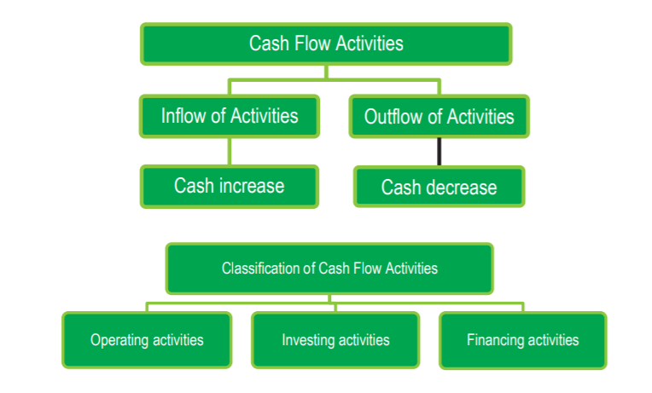
Classification of Cash Flows
According to AS-3 (Revised) cash flows are classified into three main categories:
A. From Operating Activities
B. From Investing Activities
C. From Financing Activities

Slide 10
OPERATING ACTIVITIES
Operating activities are the principle revenue-generating activities of the enterprise and other activities that are not investing or financing activities.
(i) Cash receipts from the sale of goods and the rendering of services.
(ii) Cash receipts from royalties, fees, commissions and other revenue.
(iii) Cash payments to suppliers for goods and services.

Slide 11
OPERATING ACTIVITIES
For non-financial companies | For financial companies
Receipt from sale of goods and/or rendering of services | Payment for purchase of securities
Receipt from royalties, fees and commission, etc | Payment of interest on loan
Receipt from trade receivables | Receipt from sale of securities
Payment for purchases or goods and/or services | Dividend received on securities
Payment for trade payables | Interest received on loans granted
Payment for wages, salaries, and other payment to employees | Payment of salaries, bonus, etc to employees
Receipt of premium and payment of claims | Payment of and refund of income tax unless these are identified with investing or financing activities
Payment and refund of income tax unless these are identified with investing or financing activities

Slide 12
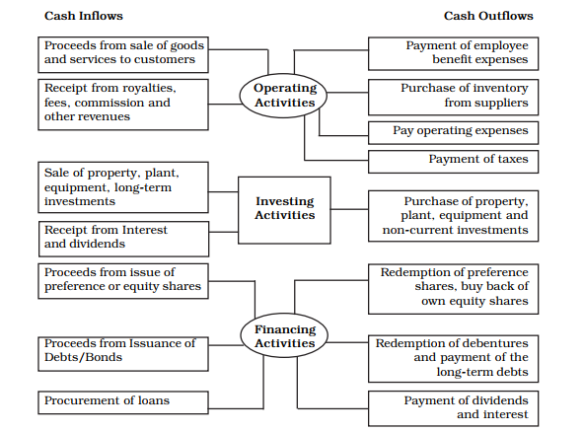
Classification of Cash inflows and Cash Outflows Activities

Slide 13
QUESTION :
Which of the following transactions are classified as Operating activities:
Cash received against sale of goods
Cash paid for purchases of goods
Payment for salaries and wages
Payment of interest on loan
Repayment of loan
Purchases of machinery against payment
Dividend paid
Sale of car in cash
Commission received
Cash received from trade receivables

Slide 14
Solution :
Cash received against sale of goods
Cash paid for purchases of goods
Payment for salaries and wages
Commission received
Cash received from trade receivables

Slide 15
INVESTING ACTIVITIES
Investing activities are the acquisition and disposal of long term assets and other investments not included in cash equivalents.
Separate disclosure of cash flows arising from investing activites is important because the cash flows represent the extent to which the expenditures have been made for resources intended to generate future incomes and cash flows.
(i) Cash payments to acquire fixed assets (including intangibles). These payments include those relating to capitalized research & development costs and self constructed fixed assets.
(ii) Cash receipts from disposal of fixed assets (including intangibles).
(iii) Cash payments to acquire shares, warrants, or debt instruments of other enterprises and interests in joint ventures.
(iv) Cash receipts from disposal of shares,

Slide 16
QUESTION :
Which of the following transactions are classified as Investing activities:
Cash proceeds from sale of fixed asset
Cash paid for purchase of stock-in-trade
Repayment of loan taken
Debenture purchased
Loan advanced
Purchase of patents

Slide 17
SOLUTION:
Cash proceeds from sale of fixed asset
Debenture purchased
Loan advanced
Purchase of patents

Slide 18
FINANCING ACTIVITIES
Financing activities are activities that result in changes in the size and composition of the owners capital (including preference share capital in the case of a company) and borrowings of the enterprise.
The separate disclosure of cash flows arising from financing activities is important because it is useful in predicting claims on future cash flows by providers of funds (both capital and borrowing) to the enterprise.
(i) Cash proceeds from issuing shares or other similar instruments.
(ii) Cash proceeds from issuing debentures loans, notes, bonds and other short-or long-term borrowings and
(iii) Cash repayments of amounts borrowed such as redemption of debentures, bonds, preference shares.

Slide 19
QUESTION:
Identify out of the following transactions that are shown as Financing Activities:
Repayment of loan taken
Proceeds from issue of shares
Debentures subscribed by the company
Redemption of preference shares
Interest paid
Dividend paid
Increase in bank OD
Issue of Bonus share

Slide 20
SOLUTION
Repayment of loan taken
Proceeds from issue of shares
Redemption of preference shares
Interest paid
Issue of Bonus share

